Slide 1
STUDENT NAME – Joshua Paul.M REGISTER NO – 711721243307 DEPARTMENT – B.Tech Artificial Intelligence and Data Science
3/21/2024 Annual Review

Slide 2
PROJECT TITLE : Real time object detection using CNN
3/21/2024 Annual Review

Slide 3


AGENDA
Problem Statement
Project Overview
End Users
Our solution and Proposition
Key Features
Modelling Approach
Results and Evaluation
Conclusion
3/21/2024 Annual Review

Slide 4

PROBLEM STATEMENT
To develop a efficient real-time object detection system utilizing Convolutional Neural Networks (CNNs).
Object detection is a fundamental task in computer vision with numerous applications such as autonomous driving, surveillance, augmented reality, and robotics
Real-time object detection is particularly crucial for applications where timely responses are necessary, such as in autonomous vehicles to avoid collisions or in surveillance systems to detect potential threats swiftly.
3/21/2024 Annual Review

Slide 5
PROJECT OVERVIEW
Brief overview of the project, highlighting the importance of real-time object detection and the challenges associated with it.
A real-time object detection system using CNNs can be implemented in Autonomous Vehicles, Advanced Driver-Assistance Systems (ADAS), Smart Surveillance Systems, Industrial Automation and Robotic and in may other fields.
Introduction to Convolutional Neural Networks (CNNs) and their relevance in object detection tasks.
As we use CNNs it minimizes errors in object detection, leading to more reliable systems.
3/21/2024 Annual Review

Slide 6

WHO ARE THE END USERS?
.
Autonomous Vehicle Manufacturers
Surveillance and Security Companies
Retail and Inventory Management
Healthcare Providers
Smart Cities and Urban Planning
Augmented Reality and Gaming
Industrial Automation
3/21/2024 Annual Review

Slide 7

YOUR SOLUTION AND ITS VALUE PROPOSITION
The proposed solution is a real-time object detection system leveraging Convolutional Neural Networks (CNNs)
This system incorporates advanced CNN architectures, optimization techniques, and hardware acceleration to achieve high-speed and accurate object detection in various applications.
Real-Time Performance: Our solution offers real-time object detection capabilities, ensuring high frame rates even in complex scenarios. This allows for timely responses in critical applications such as autonomous driving and surveillance.
Efficiency: We prioritize efficiency in terms of computational resources, memory footprint, and power consumption. Our system is optimized to run efficiently on resource-constrained devices, making it suitable for deployment in diverse hardware environments.
3/21/2024 Annual Review

Slide 8

THE WOW IN YOUR SOLUTION
Achieves real-time performance with high accuracy
Optimized for efficiency and robustness
Scalable and flexible for diverse applications
Enhances safety and security with timely detection
3/21/2024 Annual Review

Slide 9
MODELLING
Modeling for the Real-Time Object Detection System Using CNNs:
Input Data: The system takes input images or video frames from various sources such as cameras, sensors, or pre-recorded video files.
Preprocessing: Preprocessing techniques are applied to the input data to enhance its quality and prepare it for input to the CNN model. This may include resizing, normalization, and data augmentation to improve robustness.
Convolutional Neural Network (CNN) Architecture: The core of the system is the CNN model responsible for detecting objects in the input data. The CNN architecture consists of multiple layers including convolutional layers, pooling layers, and fully connected layers. State-of-the-art architectures such as Faster R-CNN, SSD, or YOLO may be used.
Training: The CNN model is trained using labeled training data, where the ground truth annotations for object locations are provided. Training involves optimizing the model parameters to minimize the detection errors using techniques like backpropagation and stochastic gradient descent.
Optimization: Once trained, the model may undergo optimization techniques to improve its efficiency and speed. This may include model pruning, quantization, and architectural modifications to reduce computational complexity.
3/21/2024 Annual Review

Slide 10
MODELLING
Hardware Acceleration: Hardware acceleration techniques such as GPU utilization or specialized hardware (e.g., TPUs, FPGAs) may be employed to further enhance the inference speed of the model, enabling real-time performance.
Inference: During inference, the trained and optimized model is deployed to detect objects in real-time. Input data is fed into the model, and object detection results are obtained efficiently and accurately.
Post-processing: Post-processing techniques may be applied to refine the detected objects, filter out false positives, and improve the overall quality of detections. Non-maximum suppression (NMS) and bounding box refinement are common post-processing steps.
Output: The final output of the system includes the detected objects along with their corresponding bounding boxes and confidence scores. This output can be visualized, logged, or further processed depending on the specific application requirements.
Evaluation: The performance of the system is evaluated using metrics such as precision, recall, mean Average Precision (mAP), and inference speed to ensure that it meets the desired criteria for real-time object detection with high accuracy and efficiency
3/21/2024 Annual Review

Slide 11
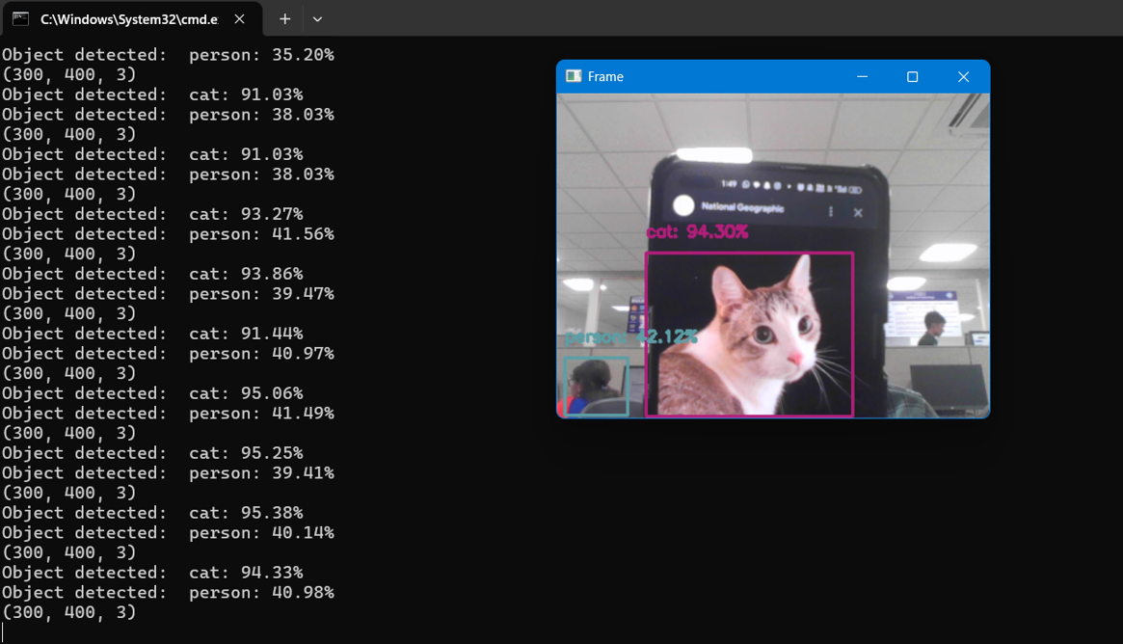
RESULTS
3/21/2024 Annual Review

Slide 12
Conclusion
In conclusion, the real-time object detection system using Convolutional Neural Networks (CNNs) presents a powerful solution for a wide range of applications requiring timely and accurate detection of objects. By leveraging advanced CNN architectures, optimization techniques, and hardware acceleration, the system achieves impressive performance in terms of speed, accuracy, efficiency, and robustness.
In summary, this system represents a significant advancement in computer vision technology, with potential applications spanning from improving road safety to enhancing security and efficiency in various domains. As technology continues to evolve, further optimizations and advancements in CNN architectures and hardware acceleration will continue to push the boundaries of real-time object detection, opening up new opportunities for innovation and impact.

